Slide 1
Maxwell’s Theory
Tom Catalano & Sam Roskos

Slide 2
James Clerk Maxwell (1831-1879)
Scottish mathematical physicist
Vastly influential in many different fields
Predicted the composition of Saturn’s rings
Developed set of equations describing electricity, magnetism and optics as subsets of electromagnetic radiation

Slide 3
Maxwell’s Equations
Maxwell’s equations are considered to be the “second great unification of physics”, after Newton’s laws
The equations describe electricity and magnetism as phenomena of the electromagnetic field
He also determined that these phenomena traveled at the speed of light, and calculated that speed, and that they acted as waves

Slide 4
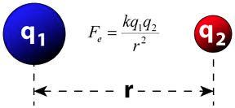
Coulomb’s Law: Biot-Savart Law:
Each law involves a proportionality constant

Slide 5
Coulomb/Biot-Savart ratio of proportionality constant has a velocity squared relation: 1/c²
What does this mean?

Slide 6
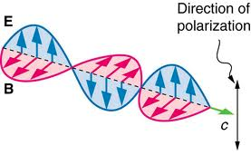
Electric and magnetic fields can propagate through space at speed C (speed of light).
Propagating E and B fields are solutions to Maxwell’s equations.

Slide 7
The Displacement Current
Maxwell used a logical argument to describe a new term in the current responsible for generating the magnetic field.

Slide 8
Maxwell and Aether
Maxwell’s equations demonstrated the wave quality of electromagnetic radiation
However it was unknown as to how these phenomena behaved as waves if they moved through space
Thus Maxwell postulated that there was a special medium, luminiferous aether, through which these waves moved

Slide 9
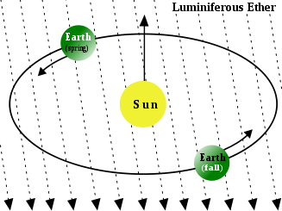
Luminiferous Aether
Aether was believed to allow the electromagnetic waves to exert forces by the Newtonian belief in direct push-pull interactions
http://www.youtube.com/watch?v=7qJoRNseyLQ
Maxwell’s equations require that light propagates at a fixed speed through a vacuum which makes aether stationary
Thus all things are moving through the “still” ether, although the aether does have directionality

Slide 10
With the limited understanding of atomic and molecular forces at the time, is it reasonable that the Newtonian belief in direct interaction would lead to the assumption of ether?
If this belief was prevalent what kind of questions and experiments could you see arising from it?

Slide 11
Proving Maxwell’s Theories
Albert Michelson and Edward Morley set out to prove Maxwell’s theories and provide backing for the ether theory
They designed an experiment, now referred to as the Michelson-Morley experiment, that they believed would detect the relative motion of matter, specifically the earth, through the stationary luminiferous ether

Slide 12
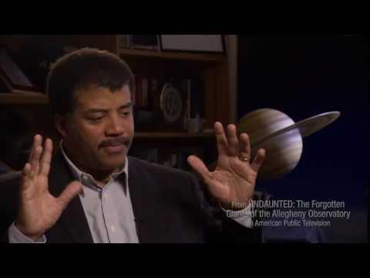

Slide 13
Experimentation
The Michelson experiment was designed to detect two different light waves, which originated from a singular light source
These light waves would combine and either show up as one concentrated beam, as fringe rings or as nothing at all
Based on the experimental design and using the ether assumption what would be expected to appear at the viewing station?

Slide 14
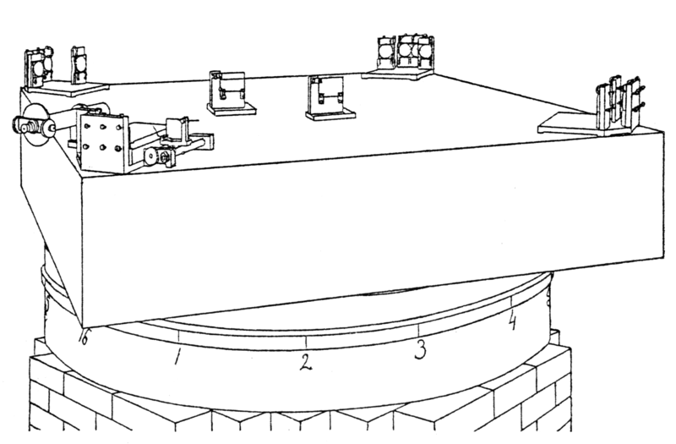
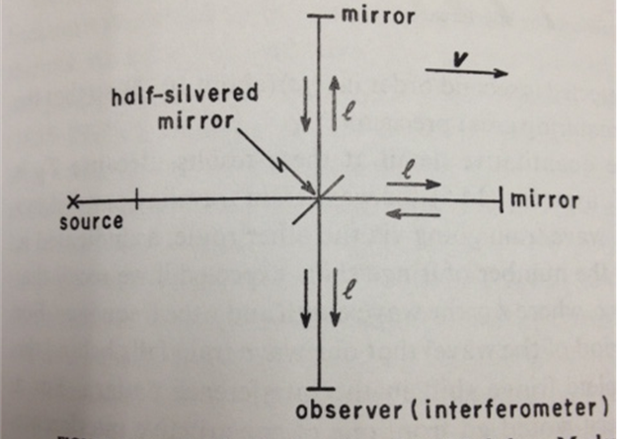
Interferometer

Slide 15
Results
The results of the experiment did not follow Michelson’s hypothesis, this led him to repeat under increasingly more sterile circumstances
This null result began to pave the way for the abandonment of aether theory and the advent of special relativity
However some scientists continued to cling to the aether model even into the 1930’s

Slide 16
Lorentz-Fitzgerald contraction
Hendrik Lorentz and George FitzGerald each set out to attempt to explain the null result of the Michelson-Morley experiment while maintaining Newtonian space and time as well as the aether model
They postulated that if the interferometer arm that was in the direction of the motion actually contracted it would create the null result that was seen

Slide 17
While evidence and experimentation began to point further from aether many scientists in the late 19th and early 20th centuries clung to their beliefs, why would their educational background limit their ability to look at relativity even when they had discovered some of its basic tenets themselves?

